Slide 1




TURFEY
Turfey- Turf Booking System

Slide 2


Our Team
GUIDED BY
Mrs. GEETHA.S ., M.E,AP/AI
TEAM MEMBERS:
AATHIRAJU.M – 811721243001
GOWRI SHANKAR.S – 811721243017
KIRUSHIGAN.R – 811721243025
RAJADURAI.M - 811721243303

Slide 3
OBJECTIVE
Introducing a user-friendly venue-finding(turf) app
Simplifying booking with intuitive search
Detailed venue info
Seamless payment.

Slide 4
PROPOSED SYSTEM
The introduction of a new app, finding and book the perfect turf is just a few clicks away.
The app is designed with convenience in mind.
It features a user-friendly interface to help users find the perfect venue.
The app also provides detailed information about each venue.
Additionally, users can easily book and pay for their slot.

Slide 5
LITERATURE SURVEY
S.NO | PAPER TITLE | AUTHOR NAME | YEAR PUBLISHED | TECHNIQUE USED | MERITS | DEMERITS
1. | Configuring an application which allows online booking and purchase of travel tickets for railway and road transport - Unified Modeling Language | Desdemona Isabela, Scărişoreanu | 2020 | 1.Recommendation Systems 2. Predictive Analytics 3. Fraud Detection 4. Natural Language Processing (NLP) | Efficiency, security, personalization, fraud prevention, optimization. | Complexity may lead to system instability.
2. | Enhanced Hotel Booking Application using PEGA | R Dhanagopal N Archana R Menaka | 2020 | Collaborative Filtering Content-Based Filtering Random Forest Decision Tree | Improved user experience, personalized recommendations | Complexity, training data availability.

Slide 6
LITERATURE SURVEY
S.NO | PAPER TITLE | AUTHOR NAME | YEAR PUBLISHED | TECHNIQUE USED | MERITS | DEMERITS
3. | The Design and Application of the Public Booking Service System | Liu Dan, Xi'an Xi'an, ChinaYue | 2020 | Collaborative Filtering Content-Based Filtering Decision Trees Neural Networks | Efficiency, accessibility, convenience, transparency, user-friendly. | Complexity, scalability issues, potential errors.
4. | BOOKAZOR - an Online Appointment Booking System | V. Akshay, Anish Kumar S, R.M. Alagappan, Gnanavel, | 2020 | Gradient Boosting Machines (GBM) Neural Networks Clustering Algorithms Time Series Analysis | Convenience for scheduling appointments, Efficient management of bookings, Accessible from anywhere. | Scalability may be challenging, Security vulnerabilities may arise, User experience might suffer.

Slide 7
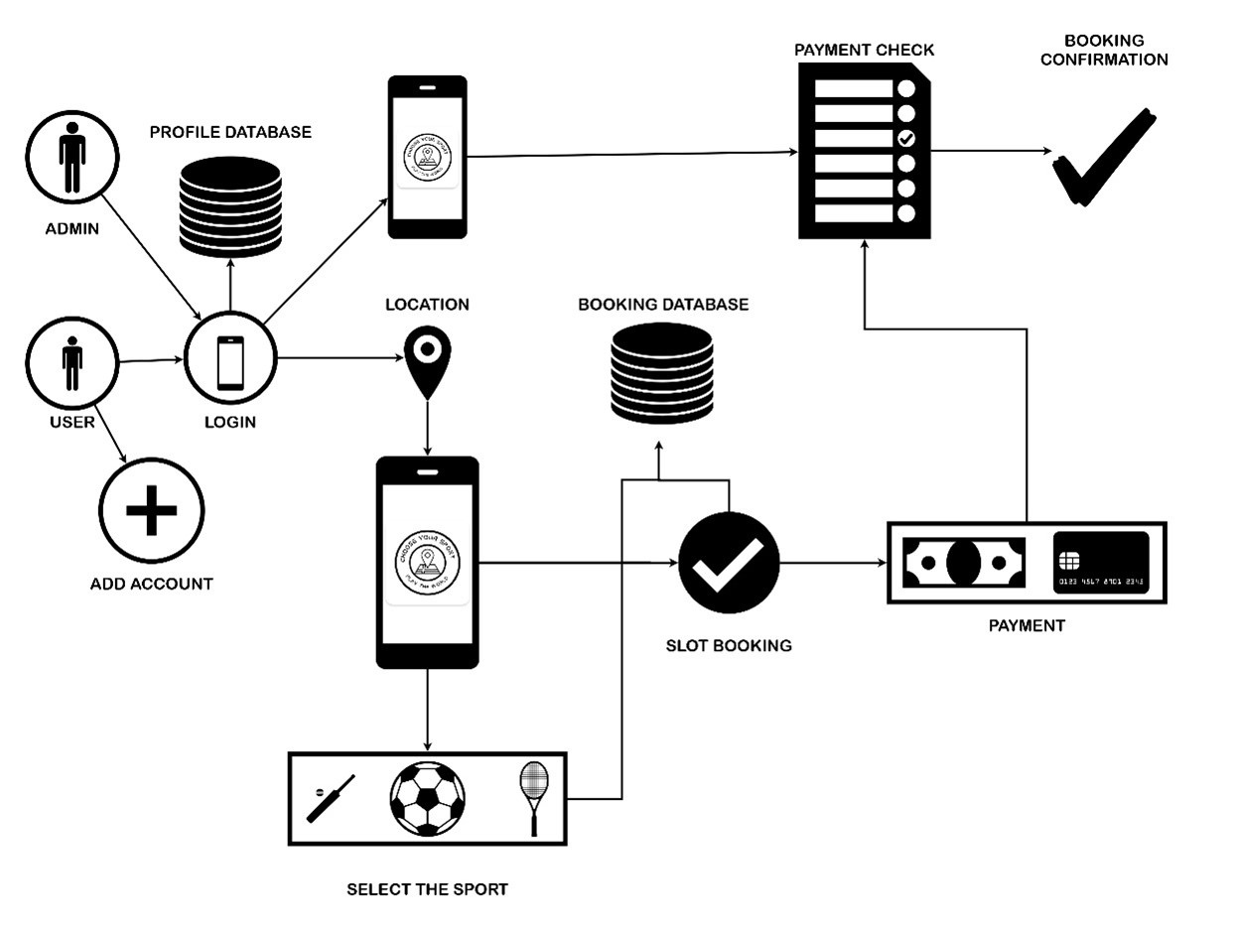
ARCHITECTURE DIAGRAM

Slide 8
SYSTEM SPECIFICATION
ANDROID DEVELOPMENT :
OS: Windows 7/8/10/11 (64-bit); macOS 10.14 (Mojave) or later; Linux including GNU C Library (glibc) 2.31 or later
RAM: Minimum 8 GB RAM, 16 GB RAM recommended
Disk Space: Minimum 4 GB, recommend 8 GB (not including system or Android SDK)
Screen Resolution: Minimum 1280 x 800
JDK (Java Development Kit): Version 11 or later
IOS DEVELOPMENT :
OS: macOS 11.0 (Big Sur) or later
RAM: 8 GB of RAM minimum, 16 GB recommended
Disk Space: At least 50 GB of free space
Xcode: Latest version (requires an Apple developer account to download)

Slide 9
MODULES
LOGIN / SIGNUP MODULE: The phase where the end users sign-up and log on to Turfey.
LOCATION MODULE: It is the phase where the end users enter their location for smooth search of near-by turfs.
RECOMMENDATION MODULE: The phase where the end users are recommended with the near-by turfs available according to the location entered.
BOOKING MODULE: The booking phase is when an end user chooses a spot(turf) from listed and book slot convenient for them.
PAYMENT MODULE: The payment for the slot booked is been carried out in this phase. The payments are prepaid & via online such as upi transactions, credit/ debit cards & online banking.
CONFIRMATION MODULE: This phase confirms the respective slots booked by an user and make progress.

Slide 10

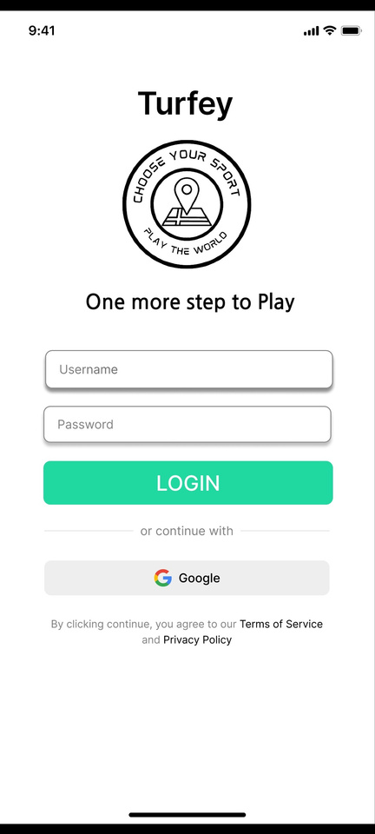
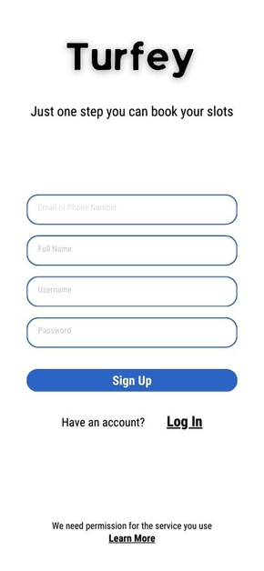

LOGIN/SIGNUP
LOGIN MODULE
ALGORITHM USED: HMAC-based One-Time Password,Email with a Verification
Link.
SIGNUP PAGE

Slide 11
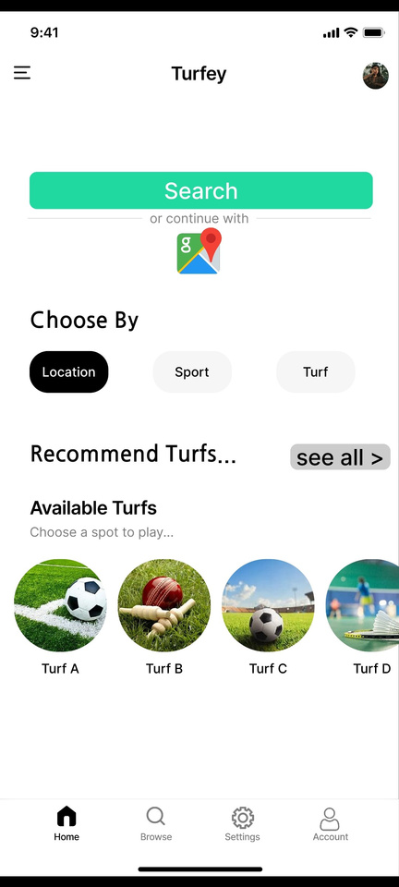

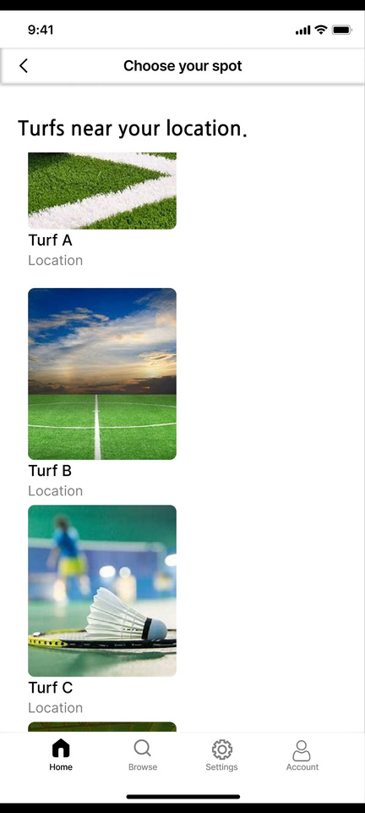
LOCATION & RECOMMENDATION
LOCATION MODULE
TECHNIQUE USED : Google Places Autocomplete API,OpenCage Geocoder.
RECOMMENDATION MODULE
TECHNIQUE USED : Collaborative Filtering, Content-Based Filtering.

Slide 12
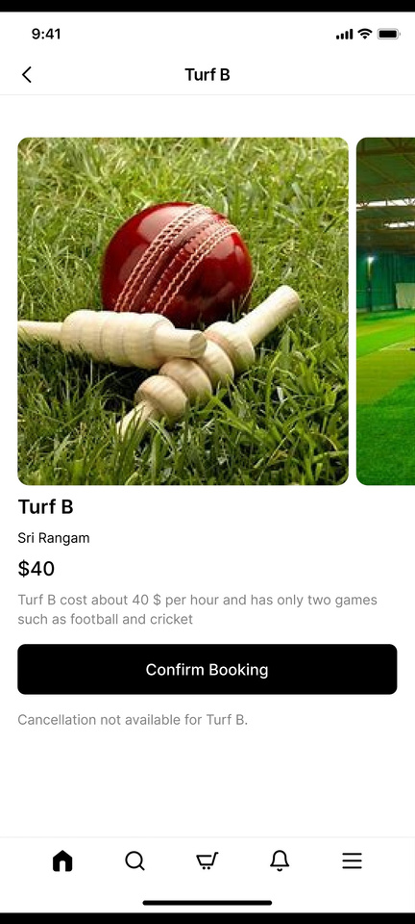

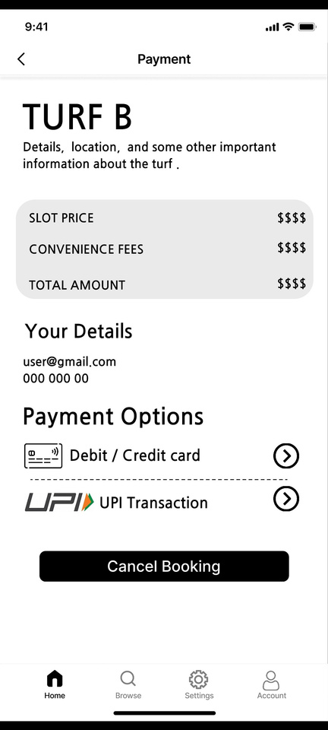
BOOKING & PAYMENT
BOOKING MODULE
ALGORITHM USED : Two-Phase Commit (2PC) Protocol.
BOOKING SUCCESSFUL
PAYMENT MODULE
ALGORITHM USED :Payment Gateway Integration.

Slide 13
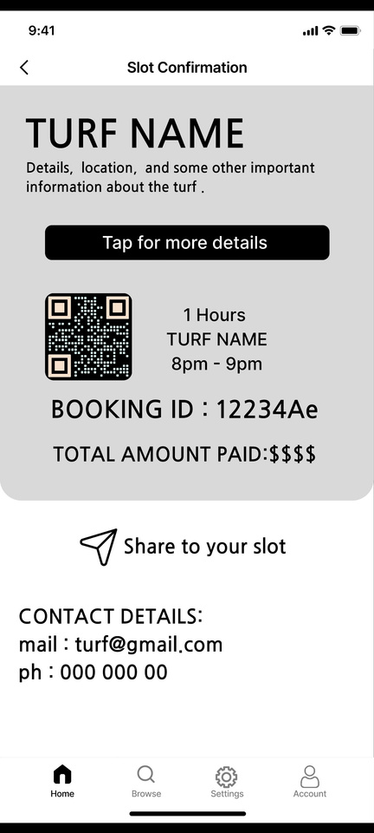

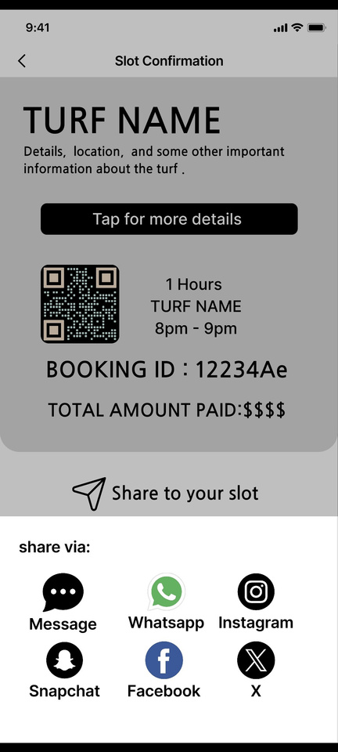
CONFIRMATION & SHARING
CONFRMATION MODULE
TECHNIQUE USED : QR Code system.
SHARING PHASE
TECHNIQUE USED :Social Media Sharing Integration.

Slide 14
CONCLUSION
The turf booking online application revolutionizes sports facility reservations, offering unparalleled convenience and efficiency to users.
With its intuitive interface and robust management tools, it simplifies the booking process and enhances administrative control.
Built for scalability and compliance, the application ensures seamless adaptation to evolving needs and regulatory standards.

Slide 15
REFERENCES:
B. Walek, J. Bartoš and R. Farana, "Fuzzy tool for proposal of suitable products in online store and CRM system", Lecture Notes in Computer Science, vol. 8669, pp. 433-440, 2014.
C. McTavish and S. Sankaranarayanan, "Intelligent agent based hotel search booking system", IEEE International Conference on Electro/Information Technology (EIT), pp. 1-6, 2010.
A. Haldorai and A. Ramu, "Canonical Correlation Analysis Based Hyper Basis Feedforward Neural Network Classification for Urban Sustainabiliy", Neural Processing Letters, Aug. 2020.
K. Baktha, "Mobile Application Development: All the Steps and Guidelines for Successful Creation of Mobile App: Case Study", A Monthly Journal of Computer Science and Information Technology, vol. 6, no. 9, pp. 15-20, 2017.

Slide 16

THANK YOU
TURFEY

